Slide 1
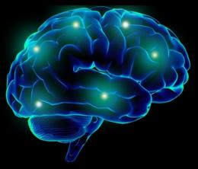
Traumatic Brain Injuries in Veterans
Alexis D. Kulick, Ph.D., ABPP
Board Certified in Clinical Neuropsychology
Greater Los Angeles VA Healthcare System
Sepulveda Ambulatory Care Center
Notes:
DURING: Since 9/11/2001, more than 2 million American service members have deployed to Iraq and Afghanistan in support of Operations Iraqi Freedom, Enduring Freedom, and New Dawn.
In the VA, Traumatic Brain Injury (TBI) has become a major focus as service members transition to veteran status. Nearly 20% of all combat Veterans have sustained a TBI, most of them mild, in severity.

Slide 2
Outline of Presentation
Traumatic Brain Injury Diagnostic Criteria
Determinants of TBI Severity
Rates of TBI among Military Personnel/Veterans
Recovery Trajectory of TBI
Mediating Influences/Comorbidities
Polytrauma System of Care in the VA
Interprofessional Rehabilitation Efforts Following TBI
Notes:
DURING: In this presentation, I am going to focus on: How TBI is diagnosed
How the severity of TBI is determined
Rates of TBI among military personnel and veterans
The typical recovery trajectory for TBI depending on severity
Mediating influences and comorbidities that interfere with the typical recovery trajectory
The Polytrauma System of Care in the VA
And rehabilitation strategies for improving functioning in patients following TBI

Slide 3
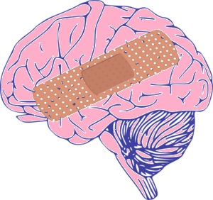
TBI Criteria (DOD)
  Any period of loss or decreased level of consciousness
  Any loss of memory for events immediately before or after the injury (retrograde/anterograde amnesia)
  Any alteration in mental state at the time of the injury
    Confusion, disorientation, slowed thinking
  Neurological deficits
    weakness, balance disturbance, motor dysfunction, change in vision, other sensory alterations, aphasia that may or may not be transient
  Intracranial abnormalities
    Contusion, Diffuse Axonal Injury, hemorrhages
Notes:
AFTER:
In civilian populations, falls are the leading cause of TBI, followed by being struck by an object and motor vehicle accidents. In military populations, many TBIs have been caused by blast exposure.

Slide 4
Notes:
DURING: Blasts can come from improvised explosive devices (IEDs) rocket-propelled grenades, land mines, artillery, rocket and mortar shells, and aerial
Bombs. Exposure to IEDs were the most common cause of combat-related concussions during Operation Enduring Freedom, Iraqi Freedom, and New Dawn.
There are four different mechanisms through which a blast can cause injury:
Primary injury: has to do with atmospheric over-pressure followed by under-pressure or vacuum, so the pressure wave enters the body and concusses the brain
Secondary injury: the impact of blast-energized debris (shrapnel) hitting the service member (penetrating and non-penetrating)
Tertiary injury: Service member being thrown by the blast and hitting environmental hazards
Quaternary injury: has to do with other injuries from the blast such as burns, crush injuries, or inhalation of gases or vapors.
For passengers in vehicles hit by a blast, such as an IED, it’s common to sustain both a primary and tertiary injury.

Slide 5
Notes:
BEFORE: Worldwide numbers represent the number of first time TBI diagnoses among active duty service members that occurred anywhere U.S. forces are located including the continental United States since 2000.

Slide 6
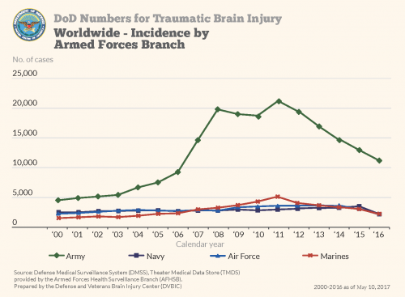
Notes:
DURING: one can see from this graph that the highest number of TBIs has occurred in Army service members.
Army – 222, 577
Marines – 53, 810
Navy – 51, 515
Air Force – 51, 617

Slide 7
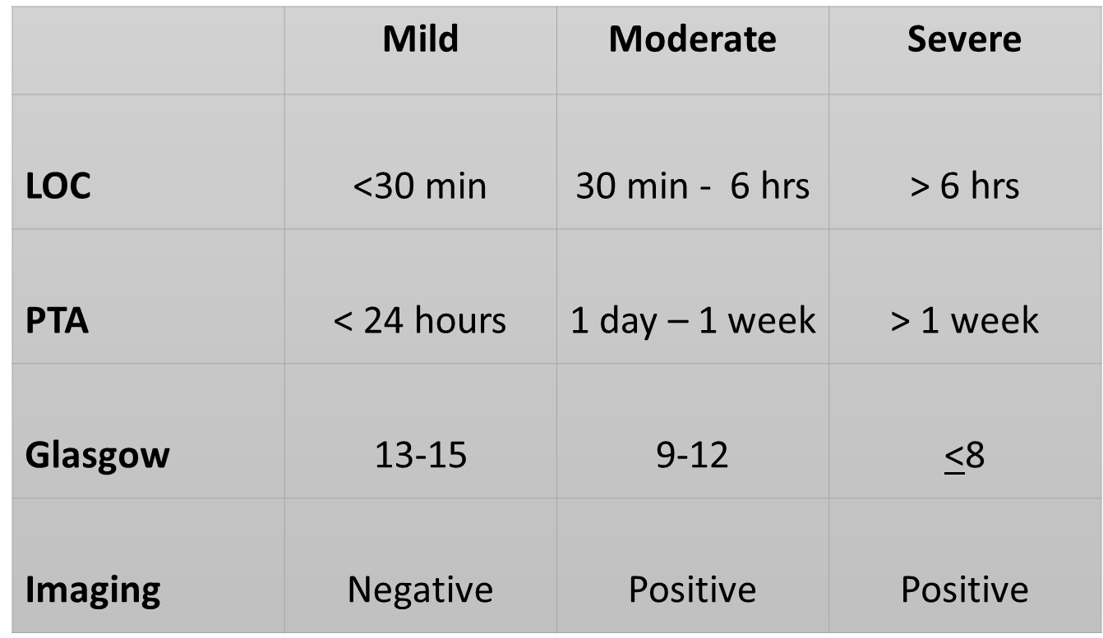
Gradients of TBI Severity
Notes:
BEFORE: Severity of the TBI is based on characteristics of the actual injury
Glasgow coma scale looks at eye opening, verbal responses, and motor responses.

Slide 8

Sequelae of TBI
Symptoms following a TBI may resolve quickly within
minutes to hours after the event or some may persist longer, depending on the
severity. Most signs and symptoms manifest immediately following the event,
and can include:
  Physical: headache, nausea, vomiting, dizziness, blurred vision, balance problems, sleep disturbance, weakness, motor changes, and sensory loss.
  Cognitive: problems with attention, concentration, new learning, memory, speed of mental processing, planning, reasoning, judgment, executive control, self-awareness, language, and abstract thinking.
  Emotional/Behavioral: depression, anxiety, agitation, irritability, impulsivity, and aggression.

Slide 9
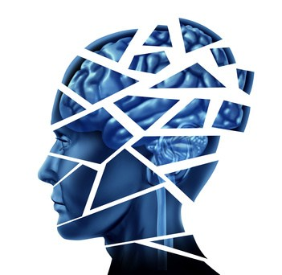
Complications after TBI
Swelling/edema
Hypoxia/ischemia
Increased intracranial pressure
Obstructive hydrocephalus
Epilepsy (more common after penetrating injury)
Vascular changes
Meningitis
Metabolic/neurotransmitter changes
Notes:
DURING:
Hypoxia – reduced oxygen
Ischemia – disruption of blood flow
Obstructive hydrocephalus – build up of cerebral spinal fluid in the brain
Meningitis – infection in the membrane surrounding the brain

Slide 10
Preinjury Functioning
Mild TBI
Brief PTA
COGNITIVE
LEVEL
Anterograde Memory Problems
I
N
J
U
R
Y
Moderate TBI
Severe TBI
PTA
PTA
Anterograde Memory Problems
Coma
Retro-
Grade Amnesia
1
7
14
1
3
6
12
Days
Months
Adapted from R.D. Vanderploeg
Notes:
BEFORE: This graph demonstrates the typical recovery trajectory for TBIs at all three levels.

Slide 11

The Course of Recovery After TBI
Recovery after TBI is measured by the level of functional performance and the presence of symptoms.
Recovery rate is faster earlier after the injury.
Deficits associated with moderate to severe TBI can result in widespread disability.
Symptoms of mild TBI typically resolve on their own within days or weeks after the injury.

Slide 12
Notes:
BEFORE: There is not only improvement in cognitive functioning within a few weeks following a mild TBI, but there are improvements in other TBI symptoms.
Headache is the symptom that tends to linger the longest and to be most problematic in terms of clinical management

Slide 13
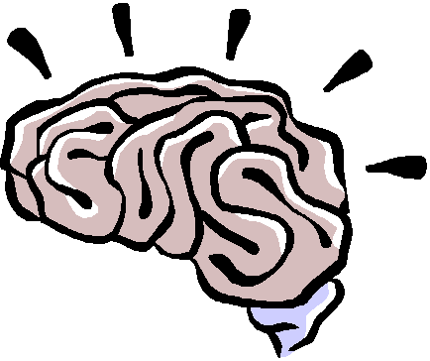
Summary of mild TBI Sequelae
Most TBIs are mild in severity (concussion), in both civilian and military populations.
Most individuals recover completely within days or weeks after a concussion.
A subgroup of people with mTBI continue to experience postconcussive symptoms beyond the expected recovery period.
Symptoms include:
  Cognitive – memory and concentration problems
  Emotional – depression, anxiety, irritability, mood lability
  Physical – headache, dizziness, fatigue, light/sound intolerance, insomnia
Research suggests this is likely related to chronic musculoskeletal issues and mental health concerns.

Slide 14
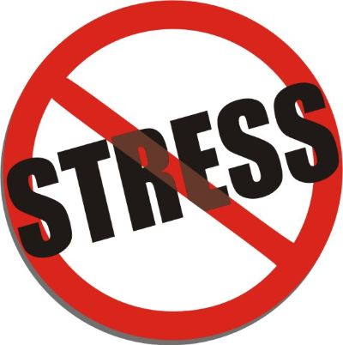
Mediating Influences
Additional mTBIs – longer recovery time
Individual characteristics – age, premorbid functioning
Psychosocial issues – SES, social support, family functioning
Post-injury stressors – financial, relational, adjustment
Psychiatric problems – PTSD, depression, anxiety
Somatic symptoms/medical conditions – chronic pain
Sleep disturbance – insomnia, nightmares
Alcohol and substance use disorders
Litigation factors – service connection, disability ratings, secondary gain issues
Patient Expectations – misattributions, fear of irreparable damage
Notes:
BEFORE: There are several factors that can interfere with the “typical” recovery trajectory from mTBI…..and these are quite common in our setting at the VA.
AFTER: There is strong empirical evidence to show that expectations exert a powerful effect on the persistence of symptoms after concussion.

Slide 15
Symptoms of PTSD & TBI
PTSD
TBI
Headache
Flashbacks/
Re-experiencing
Cognitive Deficits
Irritability/Anger
Sensitivity to light or
sound
Avoidance
Insomnia
Nausea/vomiting
Depression
Hypervigilance
Fatigue/Withdrawal
Vision Problems
Nightmares
Dizziness
Anxiety
Notes:
15
DURING: In the context of an individual who experienced a blast exposure and who has diagnoses of both mTBI and PTSD, it is very difficult to attribute certain symptoms to one diagnosis or the other. The symptoms in red are specific to PTSD and the symptoms in blue are specific to TBI; however, the symptoms in purple, in the middle of the two circles, are seen in both disorders.
The cognitive deficits include attention and memory problems, slowness in thinking, and difficulty with high-level executive functions, such as organization/problem solving. There are also mood changes, such as irritability, anger, anxiety, and depression, as well as sleep dysfunction and resulting fatigue.

Slide 16

Polytrauma System of Care in the VA
Polytrauma - injuries to multiple body parts/organ systems that is often a result of blast-related events.
  TBIs common as well as other medical conditions, such as amputation, burns, spinal cord injury, auditory and visual damage, and post-traumatic stress disorder (PTSD).
VA’s Polytrauma System of Care (PSC): integrated network of specialized rehabilitation programs dedicated to serving Veterans and Service Members with Polytrauma/TBI.
  Services include: interdisciplinary evaluation and treatment, development of a comprehensive plan of care, case management, patient and family education and training, psychosocial support, and application of advanced rehabilitation treatments and prosthetic technologies
Notes:
BEFORE: The term “polytrauma” has been introduced to encompass injuries to more than one physical region or organ system that result in physical, cognitive, psychological, or psychosocial impairments and functional disability.
Due to the severity and complexity of their injuries, Veterans and Service Members with polytrauma require a high level of integration and coordination of clinical care and other support services

Slide 17

Polytrauma System of Care/TBI Screening
How patients identified (Clinical Reminder - TBI screening)
Positive Screen → further evaluation
Results discussed with Veteran
Recommendations are made for follow-up care, as necessary
  If rehabilitation treatments are indicated, the Veteran is asked to collaborate with the rehabilitation team to develop a Plan of Care that addresses his/her recovery goals. The Plan of Care will include information about the types of treatment recommended, their frequency, and the timeline for when the rehabilitation goals are expected to be achieved.
Notes:
BEFORE: In 2007, VA implemented mandatory TBI screening for all Veterans accessing care in VA that served in combat operations and separated from active duty service after September 11, 2001. The four question screen identifies Veterans who were exposed to events that increase the risk of TBI and who experience symptoms that may be related to that specific event or events.
A positive screen does not diagnose TBI. It only indicates the need for further evaluation for possible TBI. Veterans who screen positive with the TBI screening tool are offered a Comprehensive TBI Evaluation with a specialty provider who can determine whether the Veteran has suffered a TBI.
Depending on the needs of the Veteran, other members of the rehabilitation team such as a social worker, physical and occupational therapists, speech-language pathologist, psychologist, and others may be involved in the comprehensive evaluation to help determine whether the Veteran has difficulties that may be helped with rehabilitation treatments.

Slide 18
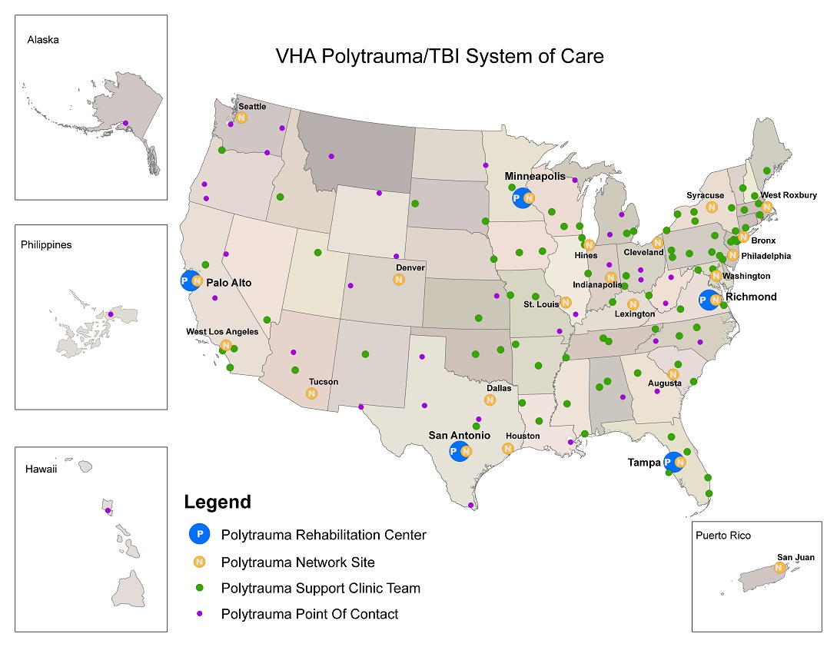
Notes:
DURING: The VA system has
5 Polytrauma Rehabilitation Centers
23 Polytrauma Network Sites
87 Polytrauma Support Clinic Teams
39 Polytrauma Point of Contact

Slide 19

VHA Polytrauma System of Care
Polytrauma Rehabilitation Centers (PRC)
5 regional referral centers for acute medical and rehabilitation care, hubs for polytrauma/TBI research and education.
Provide continuum of services, including comprehensive acute rehabilitation services for complex and severe polytrauma injuries
Located in:
  Minneapolis, MN
  Palo Alto, CA
  Richmond, VA
  San Antonio, TX
  Tampa, FL

Slide 20

VHA: Polytrauma System of Care
Polytrauma Network Site (PNS)
23 sites that provide post-acute rehabilitation for Veterans and active duty Service Members with polytrauma and TBI
includes inpatient rehabilitation, comprehensive outpatient TBI evaluations, a full range of outpatient therapy services; evaluations for durable medical equipment (DME) and assistive technology, access to other consultative specialists, and follow-up care and case management for ongoing rehabilitation needs.
There is one PNS in each VISN, except VISN 8 & 17 which have two. In VISNs with a PRC, the PRC facility also operates as the PNS.
Notes:
The Greater Los Angeles VA Healthcare System is one of the Polytrauma Network Sites.

Slide 21
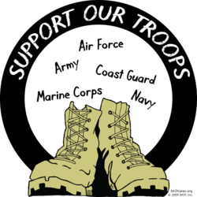
VHA Polytrauma System of Care
Polytrauma Support Clinic Teams (PSCT)
87 clinics with interdisciplinary outpatient rehabilitation services for Veterans and Service Members with mild and/or stable impairments from polytrauma and TBI.
Services include comprehensive TBI evaluations, outpatient therapy services, management of stable rehabilitation plans referred from PRCs and PNSs, coordinating access to VA and non-VA services, and follow-up care and case management for ongoing rehabilitation needs.

Slide 22

VHA Polytrauma System of Care
Polytrauma Points of Contact (PPOC)
  39 facilities that ensure that patients with polytrauma and TBI are referred to a facility and/or program capable of providing the level of rehabilitation services required. PPOCs commonly refer to the PNS and PSCTs within their region. A limited range of rehabilitation services are also available onsite at the PPOCs.

Slide 23
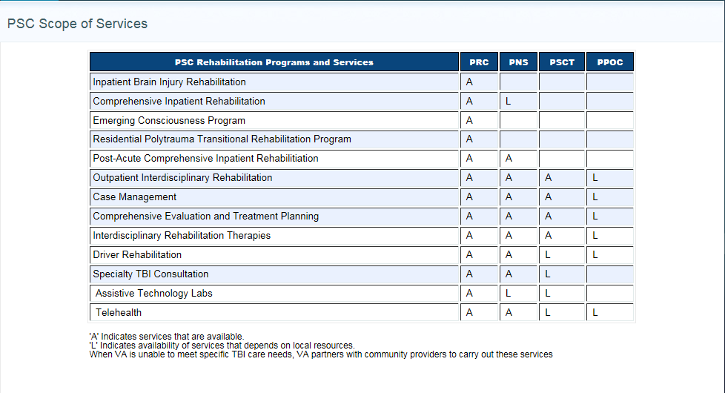
VHA: Polytrauma System of Care: Scope of Services
Notes:
BEFORE: Here is an illustration of the types of services that are available at every level.
A refers to available services
L refers to availability of services that are dependent on local resources.
When the VA is unable to meet specific TBI care needs, the VA will partner with community providers to carry out these services.

Slide 24

VA Greater Los Angeles Healthcare System
Polytrauma Network Site Team
Physiatry
Rehabilitation Nursing
Case Management (Social Work)
Neuropsychology
Occupational Therapy
Physical Therapy
Speech and Language Pathology
Orthotist/Prosthetist
Blind Rehabilitation
Outpatient Specialist
Vocational Rehabilitation
Recreational Therapy
Notes:
DURING: -It takes an integrated, interdisciplinary team to treat our Veterans with complex polytrauma injuries.
-Physiatrists are physical medicine and rehabilitation physicians who address medical problems/limitations in physical functioning as well as acute and chronic pain
-Rehabilitation nursing and social work provide case management, coordination of care, and they complete a thorough psychosocial assessment
-Neuropsychology may be consulted to perform cognitive and psychological testing and to make additional recommendations.
-Rehab therapists (OT, PT, Speech): assist with helping patients to become independent in activities of daily living, improve physical functioning, and provide speech and cognitive rehabilitation.
-There are services that allow patients to obtain prosthetics, if necessary.
BROS offers services for patients with vision impairments (double vision, photosensitivity)
Vocational rehab offers career planning services to assist if patients want to return to work or school.
Recreation Therapy: helps patients develop leisure skills, improve social skills, socialization and social support – many programs and activities (surf camp, modified skiing, equine therapy)

Slide 25
The Individualized Rehabilitation and Community Reintegration Plan of Care (IRCR)
Guides the course of treatment in TBI rehabilitation
Documents problems affecting community re-integration
Outlines the Veteran’s goals and priorities for rehabilitation
Provides information about treatments, intensity, and duration
Involves Veterans and family/caregivers in all aspects of the rehabilitation process.
Notes:
BEFORE: Once the Veteran is evaluated by each team member, an individualized rehabilitation and community reintegration plan of care is developed with the Veteran and his/her family/caregivers.

Slide 26

What Can We Do About It?
Regardless of cause(s), cognitive problems can have significant impact on real-world functioning.
Psychoeducational Interventions:
  Defining the injury and what is expected
  Normalization of symptoms
  Reassurance of positive expectations for recovery
  Providing specific coping strategies
Treat what you can
  Medical issues, especially pain and sleep problems
  PTSD/Depression and substance use disorders
    Evidence-based treatments including Prolonged Exposure, Cognitive Processing Therapy, Dialectical Behavior Therapy, CBT; mindfulness interventions, group treatments
Notes:
BEFORE: Ultimately, “what can we do about it?”
As we heard earlier, we’re not always able to determine the precise etiology of the patient’s deficits.
At the end of the day, we’re dealing with patients with cognitive problems, regardless of cause or causes, that need help as they often have a major impact on real-world functioning. Treatment is functionally based, meaning that we focus on those functions that pose barriers to successful living.
We try to get patients as psychiatrically stable as possible; patients needing substance use treatment and/or treatment of mood disorders are triaged to appropriate providers. Our multi-disciplinary polytrauma team includes physical therapy and pain specialists to help vets to deal with those issues.

Slide 27

Cognitive Rehabilitation
GOAL: To achieve the highest level of independent functioning through:
Developing an awareness of impairments
Strengthening intact functions
Substitution of new skills for lost functions
Relearning social interaction skills
Improving behavioral and emotional controls
Notes:
BEFORE: The goal of cognitive rehabilitation is to assist the patient in progressing to his or her highest level of functioning. Treatment is based on individualized goals that take into consideration the patient's strengths and weaknesses, the Veteran’s vocational and educational goals, and interests. Cognitive rehabilitation treatment goals include:

Slide 28
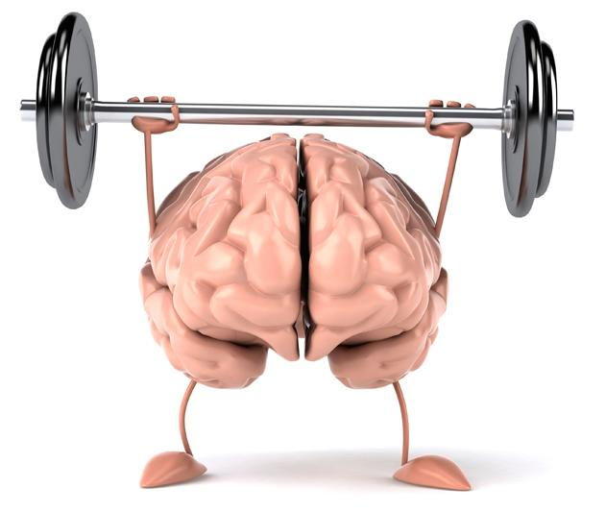


Cognitive Rehabilitation
Techniques and Tools
Restorative Treatment
  Restoring skills through exercises and drills
  Self-awareness training
Compensatory Memory Strategies
  Cognitive prosthetics
    Hi-tech: PDA, iTouch, GPS, digital voice recorders, Smart Pen, text to speech reading devices
    Low tech: Calendars, Post-Its, Reminders, Pill Boxes, Memory books
Notes:
BEFORE: Treatment is highly individualized for each person, based on what the veteran needs to function in his or her current setting, as well as the veteran’s goals for the future (school/work). After an initial diagnostic interview and discussion of patient goals, medical records and neuropsychological evaluation results are reviewed, a cognitive rehabilitation plan is developed as a collaborative effort. The achievement of goals may include a variety of techniques and tools, such as restorative treatment and Compensatory strategies. Literature suggests that compensatory strategies are most effective in terms of enhancing people’s functioning.

Slide 29


Resources on TBI
Defense and Veterans Brain Injury Center
  http://www.dvbic.org/
BrainLine – “all about brain injury and PTSD”
  https://www.brainline.org/
Veterans Health Initiatives
    https://www.publichealth.va.gov/vethealthinitiative/
  Brain Injury Association
  http://www.biausa.org/
Brain Injury Association of California
  http://www.biaca.org/

Slide 30
References
Helmick and Members of Consensus Conference (2010). Cognitive rehabilitation for military personnel with mild traumatic brain injury and post-concessional disorder: Results of April 2009 consensus conference. NeuroRehabilitation, (26), 239-255.
McCrea, M.A. (2007). Mild Traumatic Brain Injury and Postconcussion Syndrome: The New Evidence Base for Diagnosis and Treatment. Oxford University Press.
McCrea, M.A. et al. (2008). Official Position of the Military TBI Task Force on the Role of Neuropsychology and Rehabilitation Psychology in the Evaluation, Management, and Research of Military Veterans with Traumatic Brain Injury, The Clinical Neuropsychologist, 22:1, 10-26
VA/DOD (2016). VA/DOD Clinical Practice Guideline for the Management of Concussion - Mild Traumatic Brain Injury. Retrieved on October 18, 2018 from https://www.healthquality.va.gov/guidelines/Rehab/mtbi/mTBICPGFullCPG50821816.pdf

